Slide 1
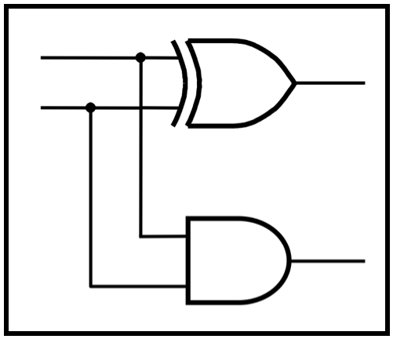
CprE 281:
Digital Logic
Instructor: Alexander Stoytchev
http://www.ece.iastate.edu/~alexs/classes/

Slide 2
Review for the Midterm Exam

